Slide 1
Software Testing

Slide 2
Who am I?
Nikolas Vourlakis
Started with Ruby on Rails
Now a backend developer @ imgZine on node.js
And I like clean code

Slide 3
Software development is hard

Slide 4
Every line of code you write has ethical implications
–Grady Booch

Slide 5
Just inherited a code base

Slide 6
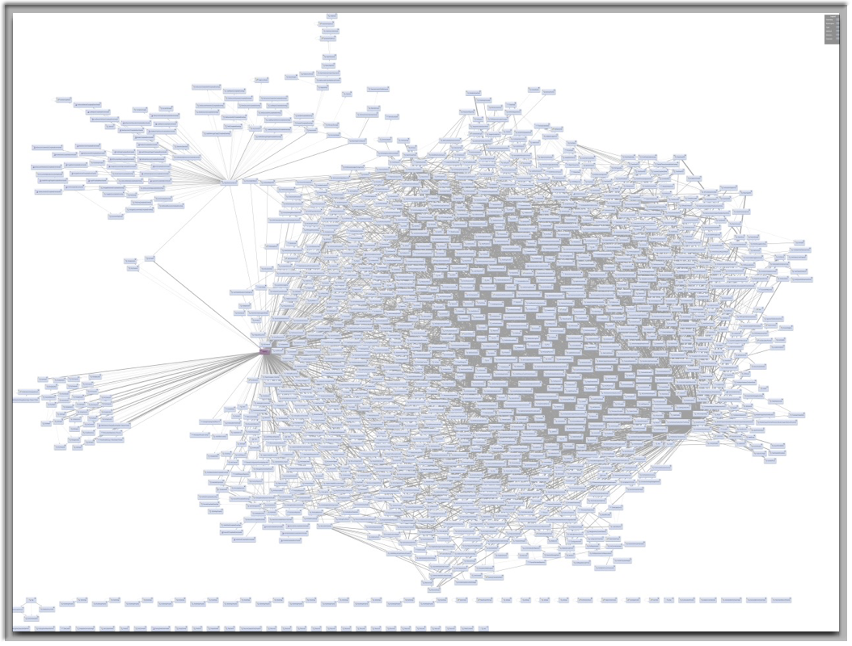

Slide 7
May I refactor a bit?
Are you sure about this?

Slide 8
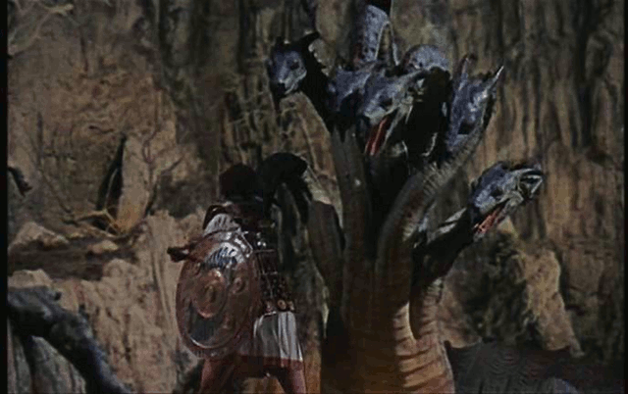

Slide 9
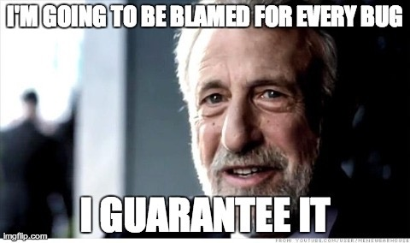

Slide 10
New project, fresh start
Amazing speed at first
Feature requests come and go
Deadlines are looming
Stress adds up

Slide 11
«Deadline is in 5 days. We are falling behind. If things can be solved with a quick hack, do it!»
–Anonymous Project Manager

Slide 12
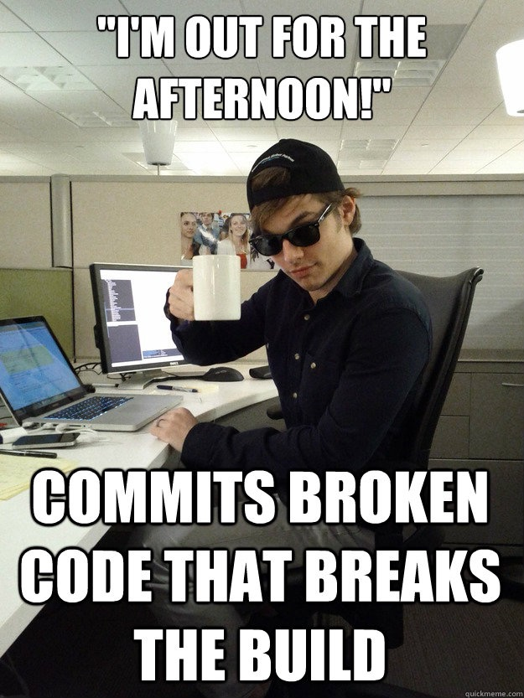

Slide 13
«It’s just a bug in the calculation of VAT when we charge the credit card. I’ll make a quick fix. No need to test.»
–Anonymous Developer

Slide 14
Where are we?
We have lost control of our code
Fear of change
No flexibility
No agility

Slide 15
Testing Overview

Slide 16
Testing Categories
Tests can be separated into 4 distinct categories:
Manual Tests / User Acceptance Tests
Functional / UI / E2E Tests
Integration Tests
Unit Tests
Notes:
voting

Slide 17
Manual Tests / UATs
Tests mirror user stories
Passing tests mean fulfillment of customer requirements
Sloooooooow: counted in days/weeks/months

Slide 18
UI / E2E Tests
Test the flow of an application from start to finish
Simulate real user scenarios
Closest automated tests to production
More often than not, they are flaky
Very hard both to develop and maintain
Very slow

Slide 19
Integration Tests
Combine tested units
Access resources (network / database)
closer to production env
Failures are hard to diagnose
Harder to maintain
Complete features might still not work
Main Target: Find bugs that UT can’t
Dependency / Environment bugs
Notes:
IT can and will use / spin up threads
Can be either system internals or multiple systems

Slide 20


Unit Tests
Test smallest unit of functionality
Isolate SUT (System Under Test)
Focus on particular feature
Validate unit performs as designed
Traceable errors
Should be extremely fast
Are extremely reliable
Leave out (non-trivial) dependencies
No network access
No database access
Do not spin threads

Slide 21


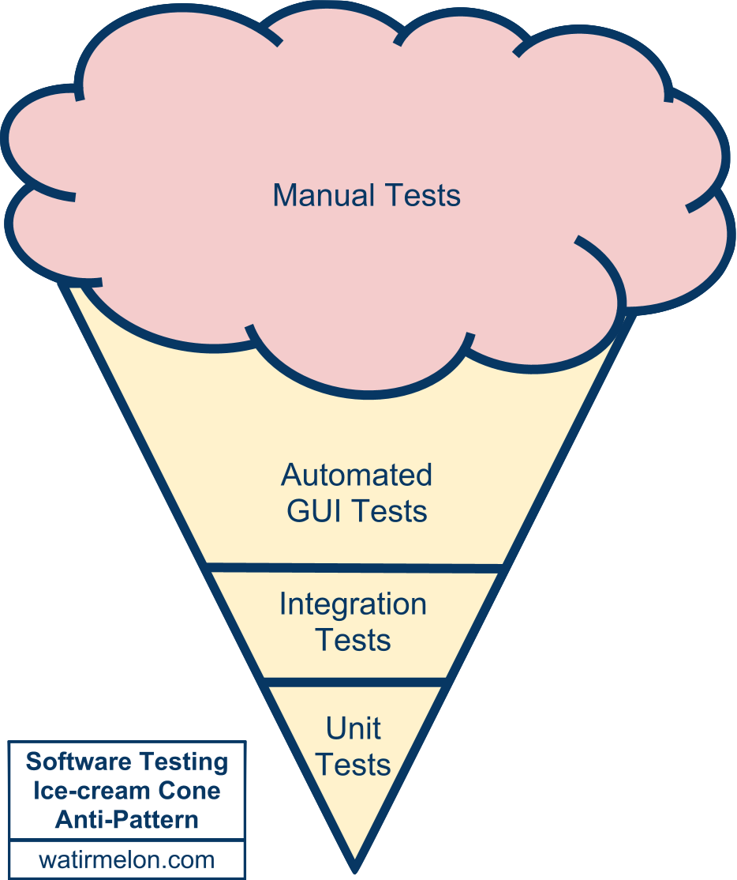
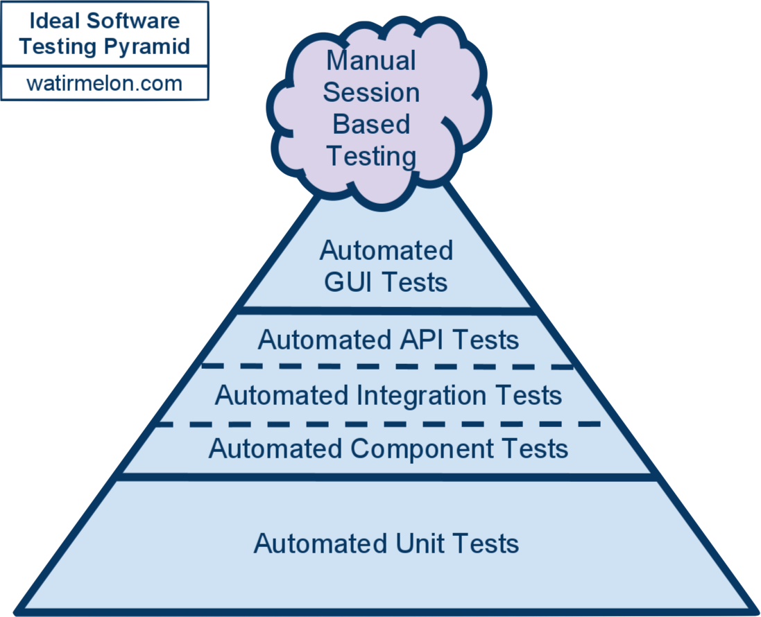
Testing Pyramid

Slide 22
CI / CD
What is it?
Development methodology
Integrate new code
Verify by automated build
and automated testing
Why use it?
Build is automated and self-testing
Test production clones
Everyone gets early feedback
Automated deployment

Slide 23

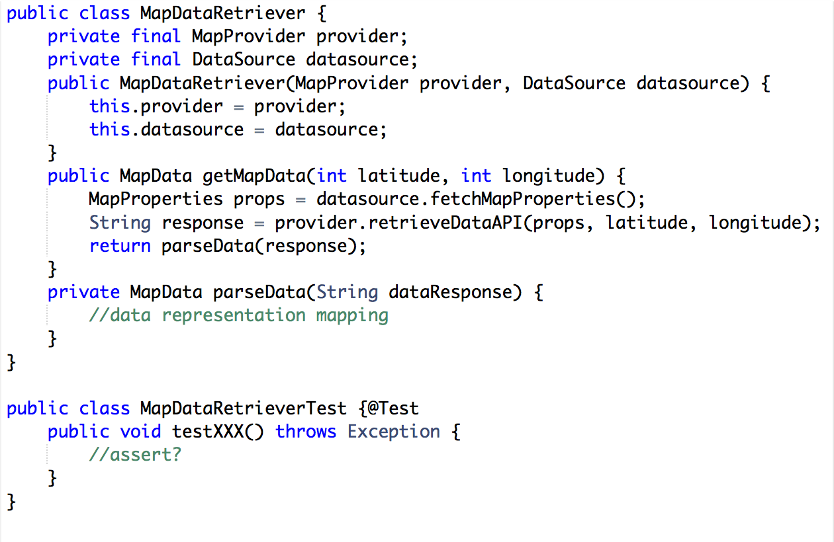
First Steps Test Case #1
How do I go about testing this?

Slide 24
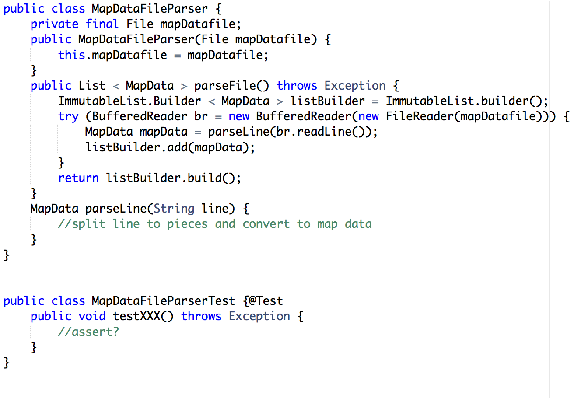
First Steps Test Case #2
How do I go about testing this?

Slide 25
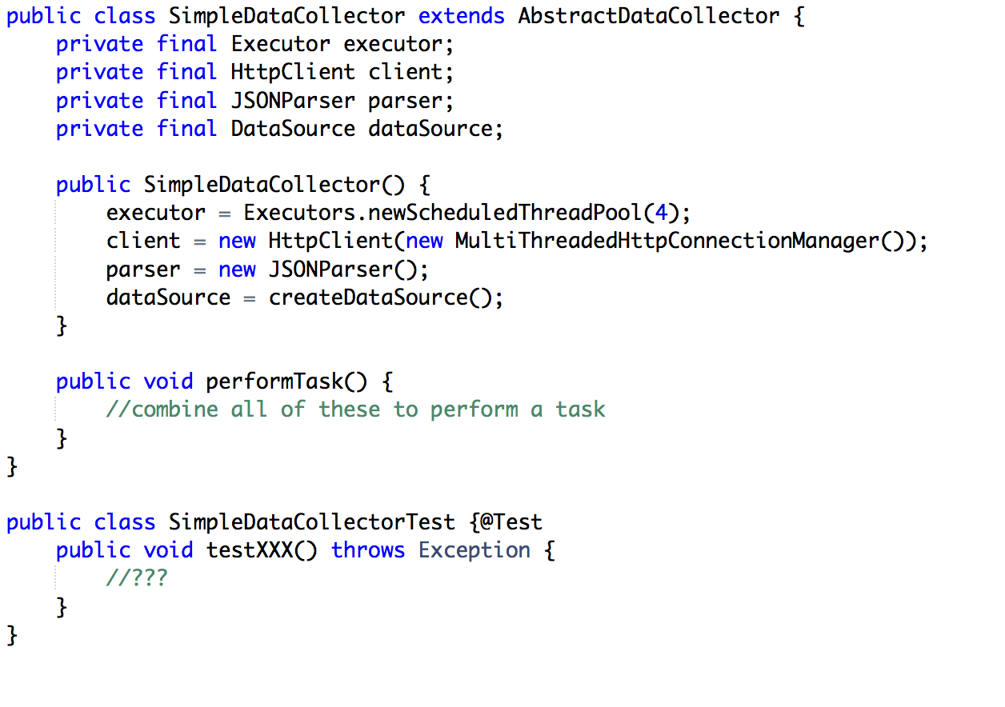
First Steps Test Case #3
How do I go about testing this?

Slide 26



The Value in Testing,
for Management
a.k.a. how to convince your boss
Notes:
Since many of you don’t do it, let’s see how you could introduce it in your company

Slide 27

But WHY do you even need to convince them?
Notes:
what sort of problems might you face when trying to convince them?

Slide 28
The Ignorant Boss Theorem
“Your code should be working already!! Why do you need tests?”
– George Boss
Notes:
well… is it really working? 1st step to solving a problem is recognising it.

Slide 29
The Blaming Manager Constant
“Well, Why haven’t you been doing it up till now?”
– John Manager
Notes:
don’t just tell them … you didn’t let me…

Slide 30
The Venture Capital-less Dilemma
“So… Let me get this right…
You are asking me to invest more money?”
– José Cheapita Nomoneda

Slide 31
The Busy Wait Loop
“We don't have time for that now”
– Antonio Bizi

Slide 32
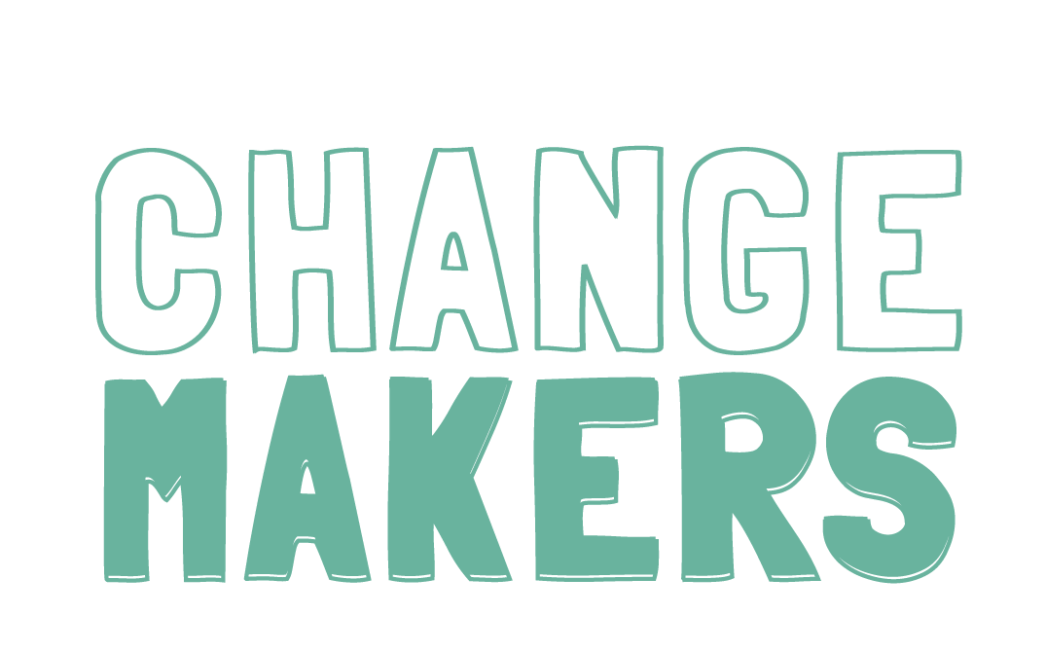
Notes:
if you’ve been convinced, YOU are the ones who need

Slide 33

How Much Time Is It Taking to Manually Test ?
Multiply by # Releases

Slide 34


How Frequent Are Your Releases?
Let’s say, in the last year?

Slide 35

Do they count customer complaints owing to bugs?
Do you even use a ticketing system?

Slide 36
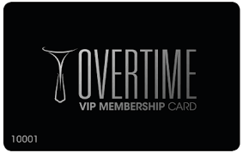
How many weekends have you worked extra?
…and they paid you for?

Slide 37

Have they had at least one client tell them:
…didn’t we fix that again a couple of weeks ago?

Slide 38
Last but not least…

Slide 39
This is really special….

Slide 40
Wait for it…

Slide 41
Ok, here goes…
their competition does it.

Slide 42

For a Happily Ever After…

Slide 43
Try to explain in business terms (free tips: ‘save money’, ‘retain customers’, ‘reduce time to market’… )
Don’t tell them how to run their business (so they don’t tell you how to code…)
Don’t expect it all at once. Change takes time => Baby Steps

Slide 44
Test - Driven Development
Let’s remove the fear
Nikolas Vourlakis

Slide 45
The Laws
You are not allowed to write any production code unless it is to make a failing unit test pass
You are not allowed to write any more of a unit test than is sufficient to fail; and compilation failures are failures
You are not allowed to write any more production code than is sufficient to pass the one failing unit test

Slide 46



Red - Green - Refactor
Make it work
Write failing
test
Make it right

Slide 47
What we gain
I am in control of the code
Fearless refactoring and thus agility
Decoupled components
Debugging? What’s that? (sort of)
Low level documentation

Slide 48
Tips to get started
Test behavior, not just functions or classes
ALWAYS write the test first
Quickly getting to green dominates everything else
Don’t forget the “make it right” part, aka clean code
Listen to your tests

Slide 49


What to read?

Slide 50
Let’s do a Code Kata
http://osherove.com/tdd-kata-1/

